Slide 1


Design of a development platform to monitor and manage Low Power, Wide Area WSNs

Slide 2
INTRO
Wireless Sensor Networks (WSNs)
Low Power, Wide Area (LPWA)
Ad hoc → shared networks
Quality of Service (QoS)

Slide 3

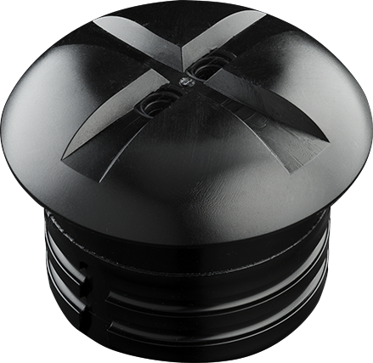

Problems
Resource constraint
Operated networks
WSN QoS is different

Slide 4
Overview
Problem & goal
Approach
Developed solutions
Distributed development platform
Resource Distribution Model
SENSIT prototype
Conclusions

Slide 5
Goal
Research and develop a software platform to monitor and manage QoS parameters of LPWA WSN applications.
How can we design abstract platform architecture for scalable processing of streams of raw sensor performance data?
How can we model the state and evaluate the QoS of a configurable system?

Slide 6
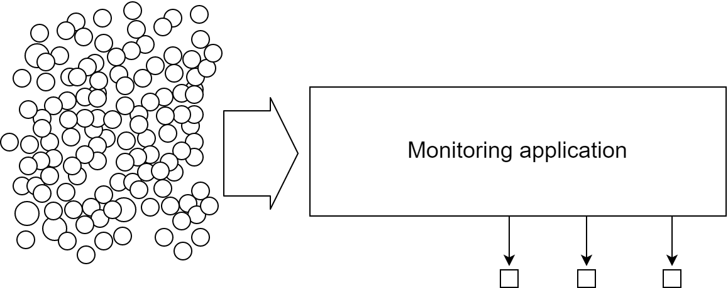
Platform architecture context

Slide 7
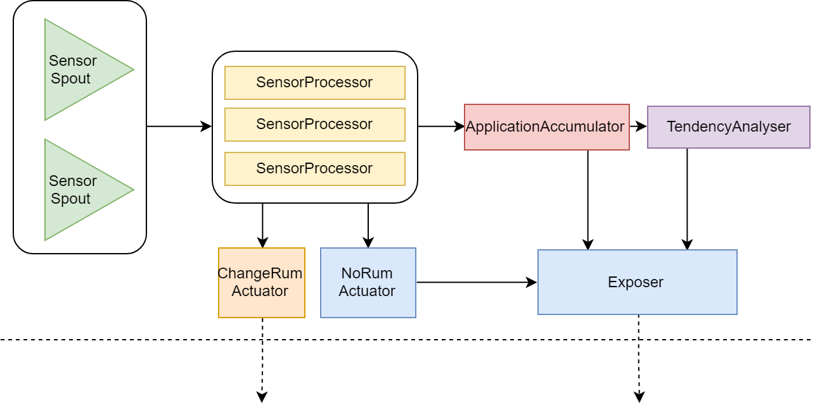
platform architecture micro-component topology

Slide 8
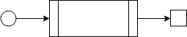
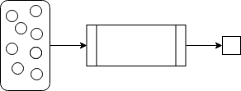
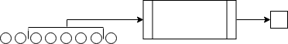
platform architecture stream operation types
Transformation
Lateral aggregation
Longitudinal aggregation

Slide 9
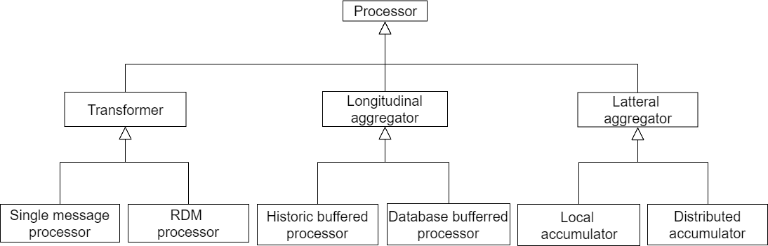
platform architecture component scaffolds

Slide 10
Research questions (2)
How can we design abstract platform architecture for scalable processing of streams of raw sensor performance data?
How can we model the state and evaluate the QoS of a configurable system

Slide 11
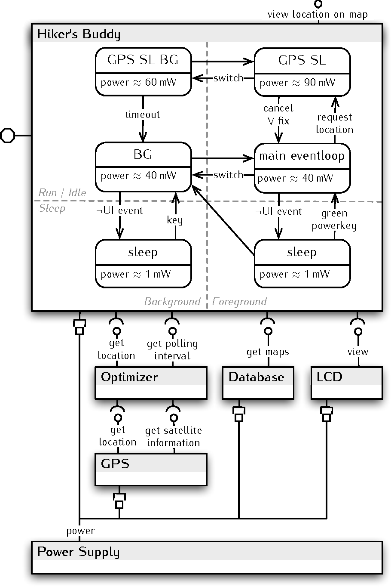
Resource Distribution Model previous work
Resources & Components
Resource Utilization Model (RUM)
(Timed) state machines
Source:
Towards Modular Resource-Aware Applications
Somayeh Malakuti, et al.

Slide 12
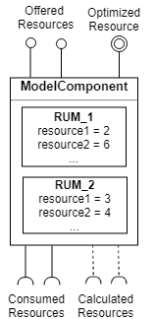
Resource Distribution Model adaptations
Multiple, generalized RUMs
Constraints on resource distribution
Optimized resource
Constraint solver

Slide 13
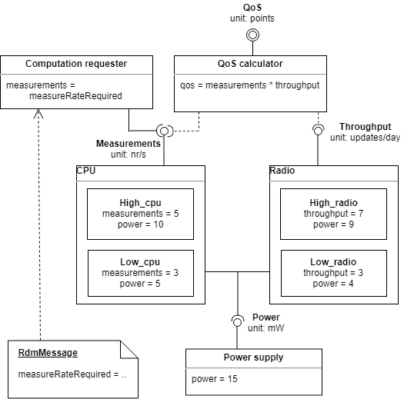
Resource Distribution Model Simple example
CPU
Configurable
Imposed min. measure rate
Radio module
configurable
Battery
Specified max. power
Goal:
Max. measure & message rate

Slide 14
Validation study Context
Nedap SENSIT
LWPA sensors
Raw, low-level Information
Multi-level reporting
sensor-level adjustments
application-level outputs

Slide 15
Validation study methodology
Prototype implementation
Applicability
Usability
Adaptations to the requirements
Adaptability

Slide 16
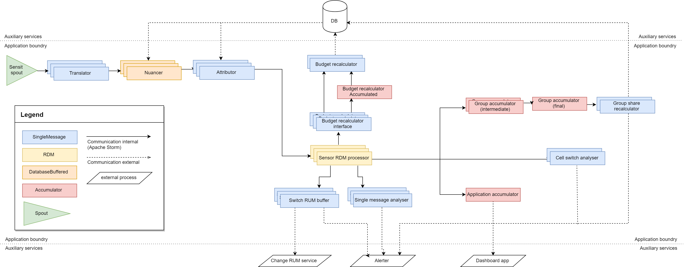
Validation study Application topology

Slide 17
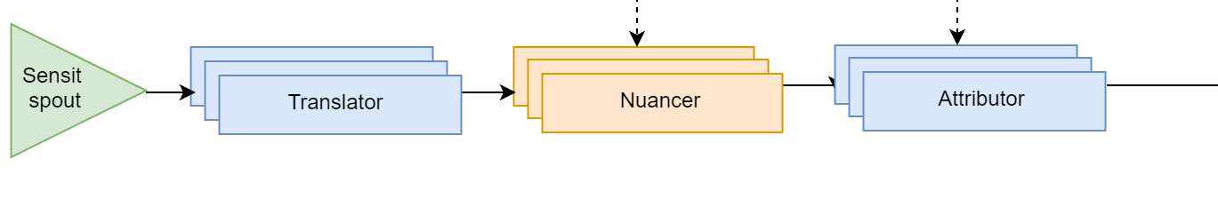
Validation study Application topology

Slide 18
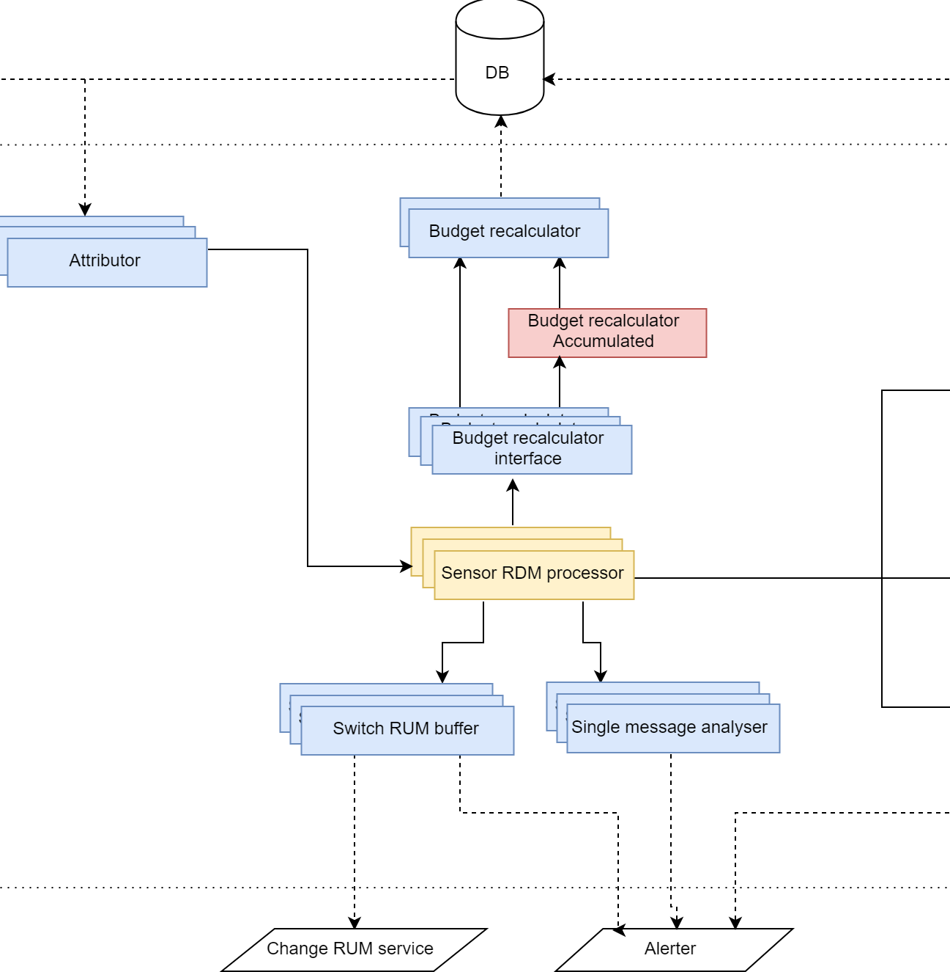
Validation study Application topology

Slide 19
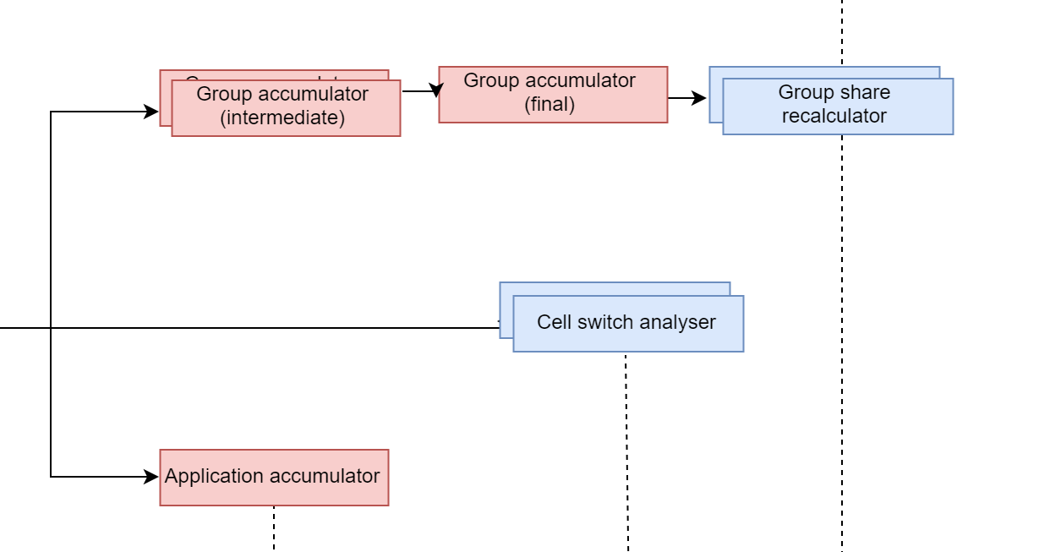
Validation study Application topology

Slide 20
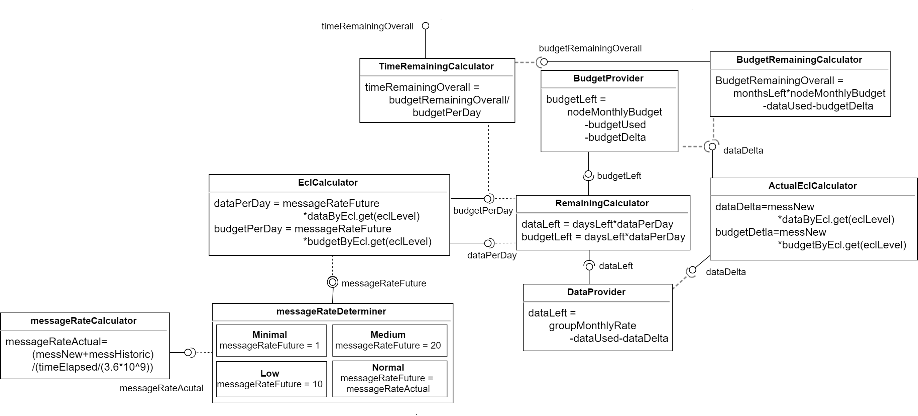
Validation study Sensor RDM

Slide 21
DEMO

Slide 22


Validation study Evaluation
Applicability
Can it be done?
Usability
Compact topology
No more code than monolith
Adaptability
2 new/changed components

Slide 23
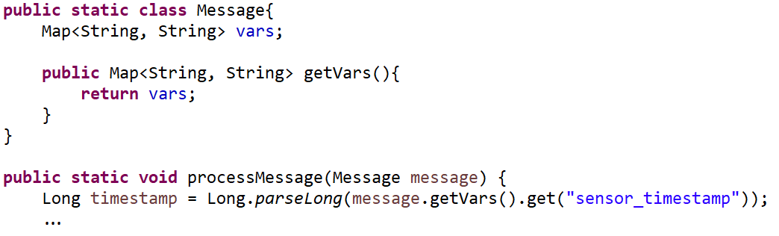
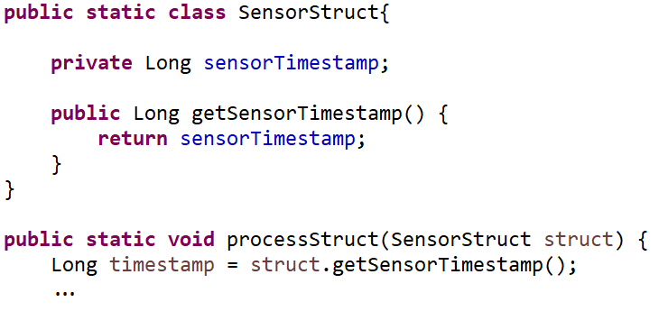
Validation study Invalid claim

Slide 24
Validation study Evaluation
Applicability
Can it be done?
Usability
Compact topology
No more code than monolith
Adaptability
2 new/changed components

Slide 25
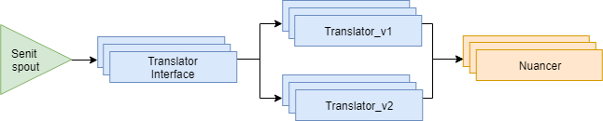
Validation study adaptability
Nuancer: DB → local
Replace Nuancer
New sensor encoding
Split input stream
Deploy second translator
Alert connectivity drop
Add functionality to existing component

Slide 26
Validation study Evaluation
Applicability
Can it be done?
Usability
Compact topology
No more code than monolith
Adaptability
2 new/changed components

Slide 27
Conclusions
Distributed architecture
Promising
Requires improvements
Resource Distribution Model
Effective
Efficient
Requires proper validation

Slide 28
Future work
Improvements to identified problems
Better incorporation of Apache Storm
Continued validation

Slide 29
Questions & Discussion
Thank you for your attention,
I will gladly answer any question you might have.

